Slide 1
Transforming Pharmacovigilance Follow-Up
Through Risk-Based, AI-Enabled Digital Engagement

Slide 2




The Challenge: From Systemic Failure to Intelligent Follow-Up
Problem Understanding
Current Follow-Up is a High-Effort, Low-Yield System
Solution Design
Our Vision: A Proactive, Reporter- Centric Intelligence Platform
A globally standardized, locally adaptive platform that uses Al-driven risk stratification to prioritize critical cases with minimal effort, ensuring
with minimal effort, ensuring regulatory-grade data
quality and audit readiness.
30 - 60 %
of adverse event (AE) cases
remain partially incomplete.
High cognitive and time burden on
healthcare professionals
Limited patient engagement and trust barriers One-size-fits-all follow-up strategies
Manual, non-prioritized pharmacovigilance workflows
This leads to delayed signal detection, increased
regulatory exposure, and avoidable patient safety risks.
Right question, directed to the right reporter, at the right time.

Slide 3
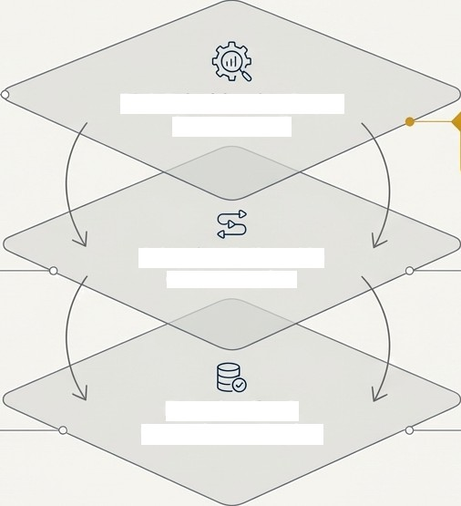
A Three-Layered Intelligence Engine
Governance &
Control
Rule-based medical and regulatory validation.
Function: Ingests case data — (Seriousness, Expectedness, Missing critical data, Reporter type) to generate a Fpllow- Up Priority Score [Low, Medium, High).
Risk Prioritization Layer
(AI-Enabled)
Model Choice: Utilizes explainable mashine iearning modeis (e.g, logistic regression, tree-based modeis) for full transparency.
Mandatory Human review and override functionality to support regulatory acceptance.
Adaptive Follow-Up Orchestration
Function: Deploys short, contextual, and case-specific questionnaires based on the risk score.
Key Features: Distinct workflows for patients vs. healthcare professionals with multilingual, region-specific templates.
Data Quality & Compliance Engine
Key Features: Mandatory field enforcement and structured E2B- compliant follow-up mapping.
Function: Ensures regulatory- grade data integrity through real-time validation anci structured mapping.

Slide 4






Engineered for Seamless Integration & Scalability
Technical Feasibility
Foundation: Built on established pharmacovigilance standards (ICSR, E2B).
Integration: Designed for modular integration with existing safety databases.
Deployment: Phased rollout by
product, region, or organization.
Risk Management & Mitigation
Mitigation Strategy
Region-specific compliance and governance framework.
Explainable models with mandatory human oversight.
Minimal-input, trust-first user
experience design.
Risk
Data privacy & Security
AI trust and adoption
Reporter engagement
Phased Rollout Plan (Next Steps)
Phase 1: Minimum viable product development.
Phase 2: Pilot implementation in a single region.
Phase 3: KPI-driven evaluation, refinement, and scalable global rollout planning.

Slide 5

Driving Measurable Improvements in Safety & Efficiency
Quantifiable Performance Gains
40 - 60 %
Improvement in FoIIow-Up Response Rates
30 - 50%
Reduction in FoIIow—Up Cycle Time
Early Identification
of Potential Safety Signals & Improved ICSR Quality
Differentiated Stakeholder Value
O
Patients
Simplified experience, increased trust, and improved safety outcomes.
Healthcare Professionals
Significantly reduced administrative burden, allowing focus on patient care.
Pharmacovigilance
Teams
Shift from reactive tasks to efficient, risk-focused safety science.
Regulators
Timely, complete, and
high-quality safety data for
better public health decisions.
Designed for Inspection Readiness , Balanced Automation and Human Accountability

Slide 6
Annexure: Technical & Regulatory Deep Dive
This presentation is supported by detailed documentation for expert review, including:
Frameworks
Sample Risk-Scoring Logic & Prioritization Framework
Governance, Audit Trail, and Human Oversight Model
Content Examples
Example Follow-Up Question Sets (Patient & HCP)
Technical Validation
AI Model Evaluation Metrics & Validation Approach
Regulatory Alignment
Detailed Alignment with ICH Guidelines and EMA GVP Principles

Slide 7

Opening the floor for discussion.
Himanshu Sharma
Himanshusharma.shriram@gmail.com
6265643703

